Slide 1
Conceptual Dynamics
Part II: Kinematics of Particles
Chapter 3
Kinematics of Particles
Plane Curvilinear Motion
Relative Motion

Slide 2
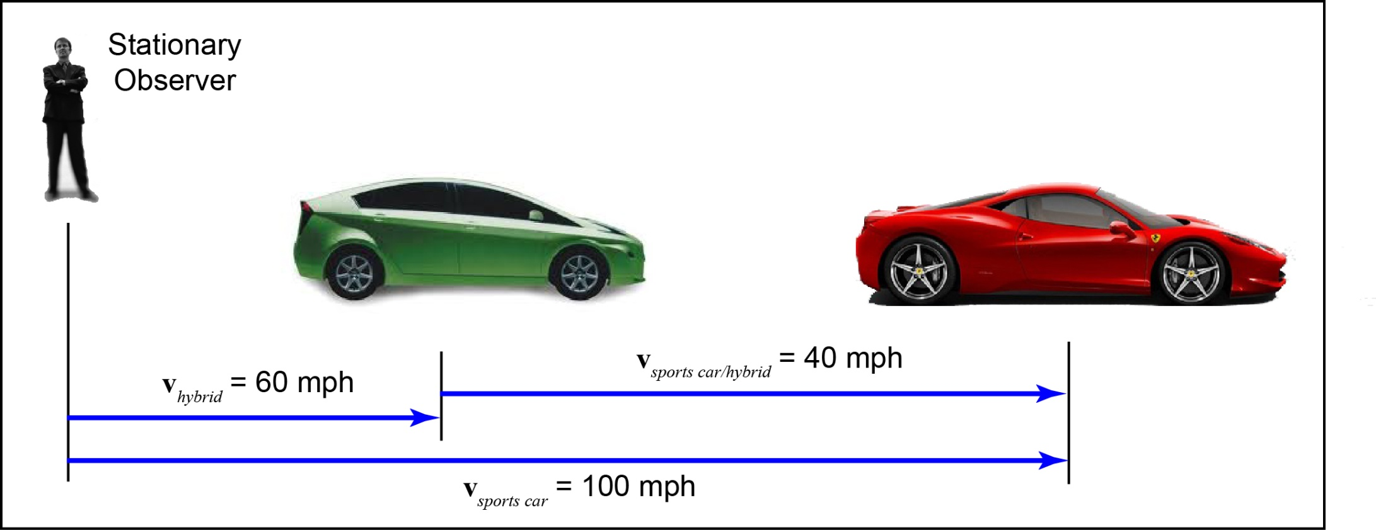
Introduction
Hybrid vs. sports car
Sometimes it is useful to describe the motion of one object relative to another

Slide 3
Reference Frame Definitions

Slide 4
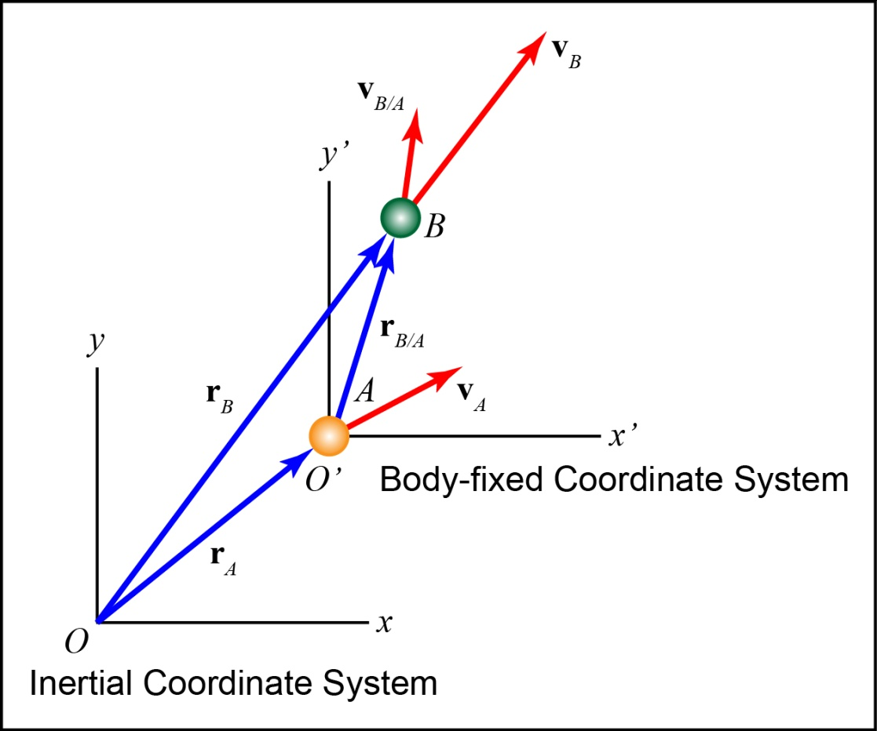
Reference Frames
Inertial Reference Frame
Non-accelerating which implies non-rotating
We will also assume non-moving
Non-Inertial Reference Frame
Accelerating and may also rotate
Body-fixed Reference Frame
Fixed to a usually moving body

Slide 5
Reference Frames
Position, velocity and acceleration can be described in terms of;
Inertial coordinates
Body-fixed
coordinates

Slide 6
Absolute and Relative Motion

Slide 7
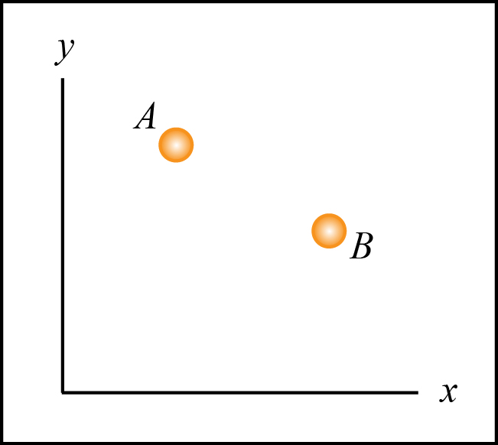
Relative Position
What is the difference between absolute position and relative position?
Absolute?

Slide 8
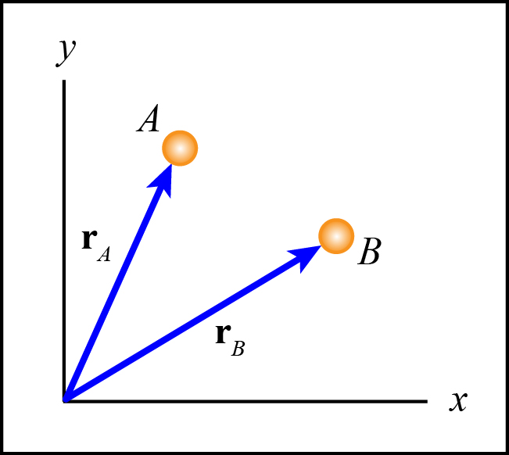
Relative Position
What is the difference between absolute position and relative position? (absolute)
Absolute positions are measured from a stationary coordinate system (inertial).
r_{A} = Absolute position
vector of particle A.
r_{B} = Absolute position
vector of particle B.

Slide 9
Relative Position
What is the difference between absolute position and relative position?
Relative?

Slide 10
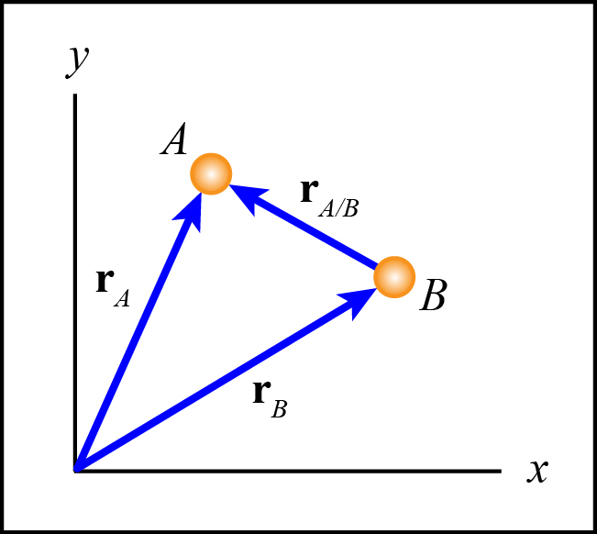
Relative Position
What is the difference between absolute position and relative position? (relative)
Relative positions are usually measured from another moving particle (moving coor. system).
r_{A/B} = Relative position
vector of particle A with
respect to particle B.

Slide 11
Relative Position
Through vector addition we can relate absolute and relative positions.
What is r_{A?}

Slide 12
Relative Position
Through vector addition we can relate absolute and relative positions.
What is r_{A?}

Slide 13
Relative Velocity
Velocity is the time rate of change of position.

Slide 14
Relative Acceleration
Acceleration is the time rate of change of velocity.

Slide 15
Important Equations
Therefore,

Slide 16
Conceptual Example 3.6-1
Consider a train moving along a track. The speed of the train is given in the figure. A person is walking inside the train in the direction shown with the speed shown relative to the train.

Slide 17
Conceptual Example 3.6-1
A stationary observer watches the walking person. In which situation does the person walking inside the train appear to the stationary observer to be walking the fastest to the stationary observer and which is the slowest?

Slide 18
Fastest ___ Next ___ Next ___ Slowest ___

Slide 19
C
B
D
A
Fastest ___ Next ___ Next ___ Slowest ___

Slide 20
Relative Velocity
Video
Common Physics Misconceptions

Slide 21
Example Problems
EP3.6-2
EP3.6-3

